Slide 1
Comparison between ORION AD and Chronic AD
Peng Tan / Siqi Zhou

Slide 2
Agenda
Background
Purpose
Comparison
Triggering rule
Data source
Features *
motivation / purpose | features
Basic checking | pair correlation
Accuracy improvement | time weighted analysis
 | FMEA
 | domain knowledge
 | past lesson learnt / users’ feedback
Further accuracy improvement (adding in new datasets) | new datasets SWR/QDR/lot attribute
 | PM/CM checking (future: Fault detection)
friendly UI | plot enhancement
Reduce false alarms / Provide more meaningful root causes / Smarter AD | channel level analysis
 | single context removal
 | curve trending detection

Slide 3

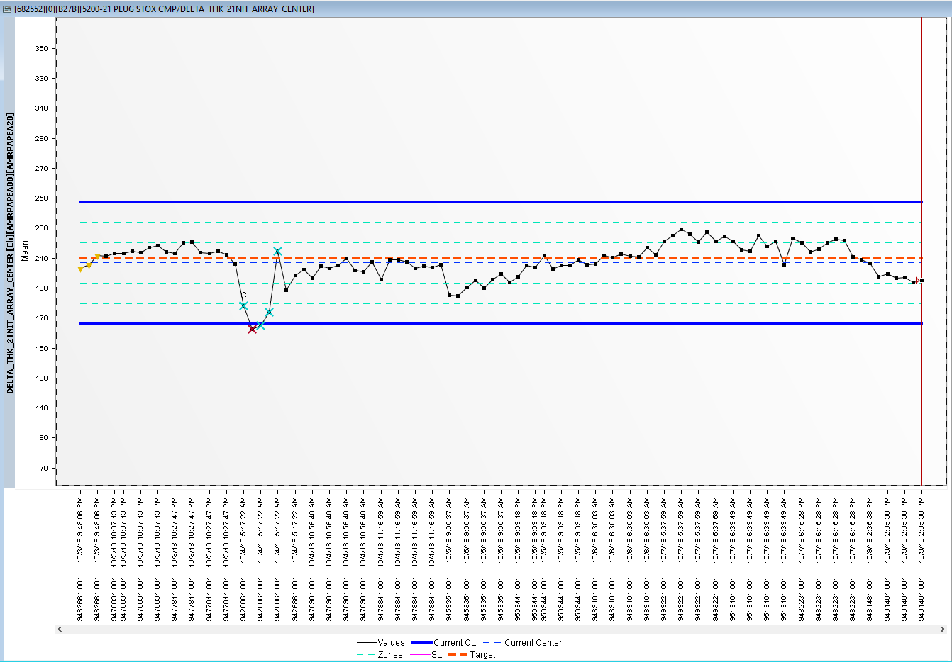
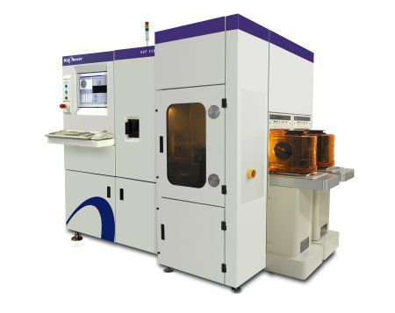

Auto Diagnostics
Background
SPACE Charts
SPC

Slide 4
Auto Diagnostics
Background
Out-of-Control
(OOC) Limit
Out-of-Control
(OOC) Points

Slide 5
Auto Diagnostics
Purpose
This project aims to provide engineers with the most probable root cause(s) of a Out of Control (OOC) point in the SPACE (Inline) control chart.

Slide 6
Comparison
 |  | ORION AD | Chronic AD
 |  |  | RDA AD | PEE AD
Triggering rule |  | Real-time | scheduled daily
Data source | SPACE | in messages (max 30 points) | Hive (latency: ~3h)
 | Sigma | streaming cluster, HBase, sigma (data latency: <15 mins) | prod cluster, HBase, sigma (data latency: 40mins~1h)
 | Teradata | N/A | new datasets SWR/QDR/lot attribute/PM_CM checking are using Teradata
Feature | Basic checking | pair correlation | pair correlation
 | Accuracy improvement | N/A | time weighted analysis
 |  |  | FMEA | N/A
 |  |  | domain knowledge | N/A
 |  |  | past lesson learnt / users’ feedback
 | Further accuracy improvement (adding in new datasets) | N/A | new datasets SWR/QDR/lot attribute
 |  |  | PM/CM checking (future: Fault detection)
 | friendly UI | N/A | plot enhancement
 | Reduce false alarms / Provide more meaningful root causes / Smarter AD | N/A | channel level analysis
 |  |  | single context removal
 |  |  | curve trending detection

Slide 7
Comparison 1 - triggering rule
 | ORION AD | Chronic AD
 |  | RDA AD | PEE AD
Triggering rule | Real-time | scheduled daily | scheduled daily
 | 1. Chart has minimum 2 OOC points and 2 good points in same chart type for 30 points. | 1. Chart has minimum 2 OOC points and 2 good points in same chart type for last 30 days. | 1. Chart has minimum 2 OOC points and 2 good points in same chart type for last 30 days.
 | 2. Chart types are mean, sigma, range and ewma-mean. | 2. Chart types are mean, sigma, range and ewma-mean. | 2. Chart types are mean, sigma, range and ewma-mean.
 | 3. Analyzed base on the chart type sequence: mean>sigma>range>ewma-mean. | 3. For multiple chart type highlighted in the Chronic OOC chart list, the chart type with most OOC points will be analyzed by AD. [1] | 3. For multiple chart type highlighted in the Chronic OOC chart list, the chart type with most OOC points will be analyzed by AD. [1]
 | 4. Trigger by per eCAP and also need to satisfy rule 1 above. | 4. Check whether there are at least 2 OOC points within 3 days. | 4. use Chronic OOC chart list from SPC team.
Reference:
[1] e.g. one chart was highlighted both in chart type ‘mean’ and ‘sigma’ and the assumption is the chart got more OOC points in ‘mean’ than ‘sigma’, AD will only trigger analysis for chart type ‘mean’.

Slide 8
Comparison 2 - Data source
 |  | ORION AD | Chronic AD
 |  |  | RDA AD | PEE AD
Data source | SPACE | in messages (max 30 points) | Hive (latency: ~3h)
 | Sigma | streaming cluster, HBase, sigma (data latency: <15 mins) | prod cluster, HBase, sigma (data latency: 40mins~1h)
 | Teradata | N/A | new datasets SWR/QDR/lot attribute/PM_CM checking are using Teradata

Slide 9
Comparison 3 - Feature
 |  | ORION AD | Chronic AD
 |  |  | RDA AD | PEE AD
Feature | Basic checking | pair correlation | pair correlation
 | Accuracy improvement | N/A | time weighted analysis
 |  |  | FMEA | N/A
 |  |  | domain knowledge | N/A
 |  |  | past lesson learnt / users’ feedback
 | Further accuracy improvement (adding in new datasets) | N/A | new datasets SWR/QDR/lot attribute
 |  |  | PM/CM checking (future: Fault detection)
 | friendly UI | N/A | plot enhancement
 | Reduce false alarms / Provide more meaningful root causes / Smarter AD | N/A | channel level analysis
 |  |  | single context removal
 |  |  | curve trending detection

Slide 10
Features

Slide 11
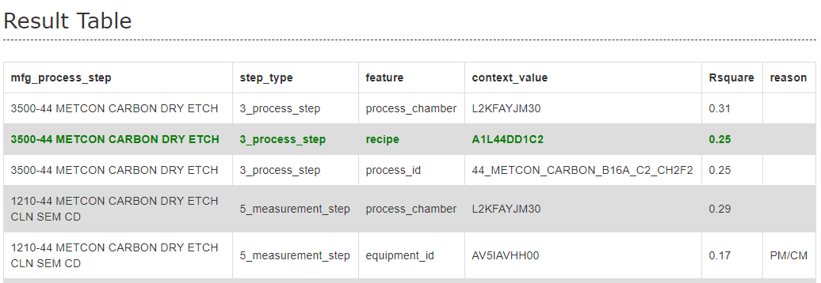
Pair correlation
Basic checking; Available in ORION/RDA/PEE AD
OOC | Chamber 1 | Chamber 2
1 | 0 | 1
1 | 1 | 1
1 | 0 | 1
0 | 1 | 0
0 | 0 | 0
0 | 1 | 0
To better understand how correlation is calculated in above table, we use a simple example to illustrate:
When we calculate the correlation between chamber 1 vs OOC, the value is -0.2. Low correlation.
When we calculate the correlation between chamber 2 vs OOC, the value is 0.8. High correlation.

Slide 12
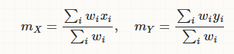
Time weighted analysis
Accuracy improvement; Available in RDA/PEE AD
Weighted correlation (Link)
Equal weighted
Time weighted

Slide 13
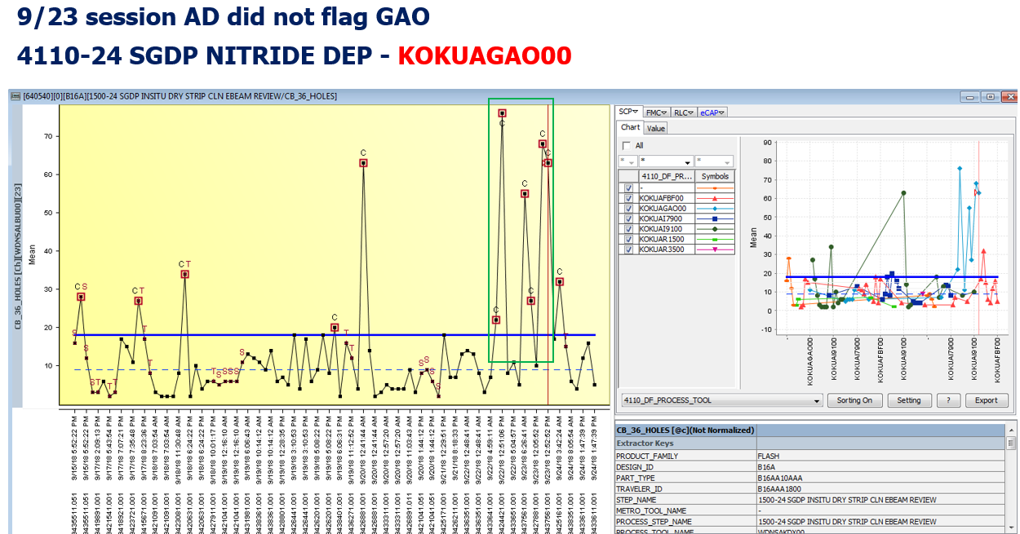
Time weighted analysis
Accuracy improvement; Available in RDA/PEE AD
RDA user Si Min gave a feedback that AD didn’t flag out equipment KOKUAGAO00.
This feature currently is available for both RDA AD and PEE AD.
AD will focus on the latest OOCs.
Toggles matches in the latest OOC time period will have much higher correlation value than early period.
Current Rsquare value is calculated by this time weighted correlation. The higher Rsquare is, the better match between potential toggles and OOC points.

Slide 14
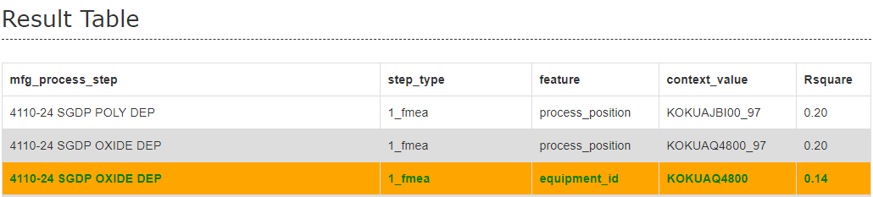
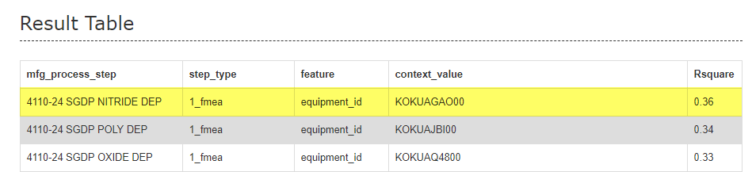
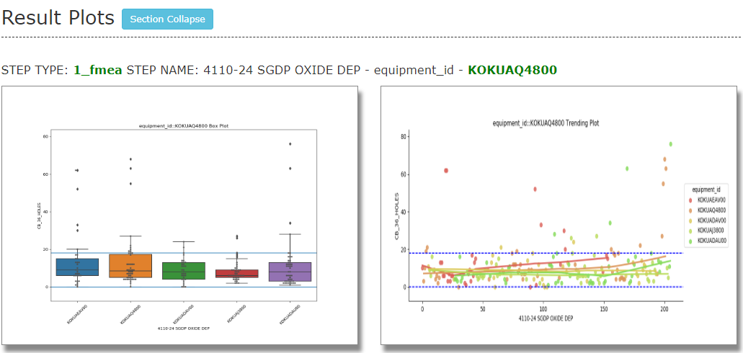
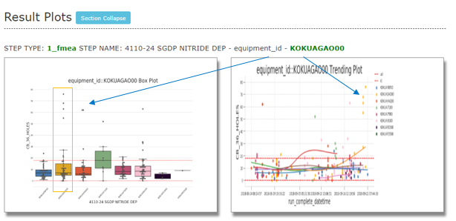
Time weighted analysis
Accuracy improvement; Available in RDA/PEE AD
Before
After

Slide 15
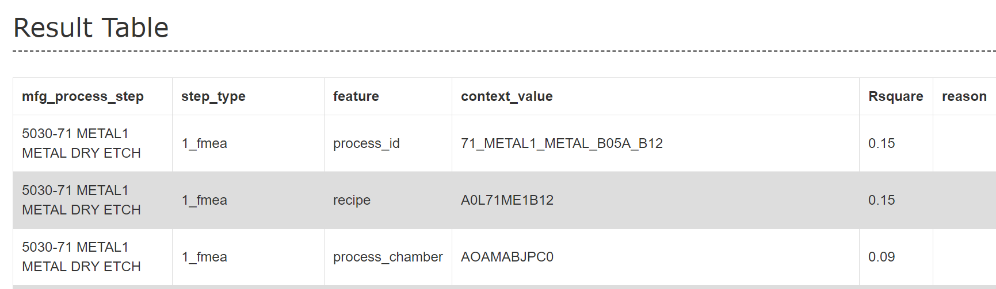
FMEA
Accuracy improvement; Available in RDA AD
This feature currently is only available for RDA AD.
A list contains measurement step, process step and corresponding channel id.
This list is prepared by RDA team so far.
AD will check whether channel id is in the list and mark corresponding process step as FMEA step.
FMEA List Example
Measurement Step | Process Step | Channel Id
1000-82 PASS PHOTO MACRO INSP | 3010-82 PASS PHOTO | 716608
1000-82 PASS PHOTO MACRO INSP | 3010-82 PASS PHOTO | 716609
1000-82 PASS PHOTO MACRO INSP | 3010-82 PASS PHOTO | 716610
1000-82 PASS POLYIMIDE ANNEAL 2 WIS INSP | 3010-82 PASS PHOTO | 716616
1000-82 PASS POLYIMIDE ANNEAL 2 WIS INSP | 3010-82 PASS PHOTO | 716617
1000-82 PASS POLYIMIDE ANNEAL 2 WIS INSP | 3010-82 PASS PHOTO | 716618
1000-02 ALIGN MARK INSITU DRY STRIP MICRO INSP | 5200-23 PERIPH OXIDE CMP | 716622
1000-02 ALIGN MARK INSITU DRY STRIP MICRO INSP | 5200-23 PERIPH OXIDE CMP | 716623
1000-02 ALIGN MARK INSITU DRY STRIP MICRO INSP | 5200-23 PERIPH OXIDE CMP | 716624
1000-28 W0 METAL SPUTTER MICRO INSP | 3010-28 W0 PHOTO | 716628
1000-28 W0 METAL SPUTTER MICRO INSP | 3010-28 W0 PHOTO | 716631
1000-28 W0 METAL SPUTTER MICRO INSP | 3010-28 W0 PHOTO | 716632

Slide 16
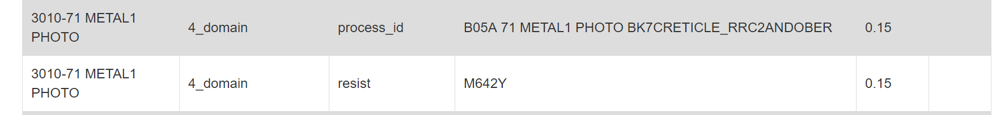
Domain knowledge
Accuracy improvement; Available in RDA AD
This feature currently is only available for RDA AD.
A list contains RDA defect parameter and corresponding process step pattern.
This list is prepared by RDA team so far.
AD will check whether defect parameter is in the list and mark corresponding process step as Domain Knowledge step.
Domain Knowledge Example:
“CB_32_RESIDUAL_FILM”: current loop CMP, WP or WET ETCH steps.
“CB 19_RESIDUE”: current loop after PHOTO steps.

Slide 17
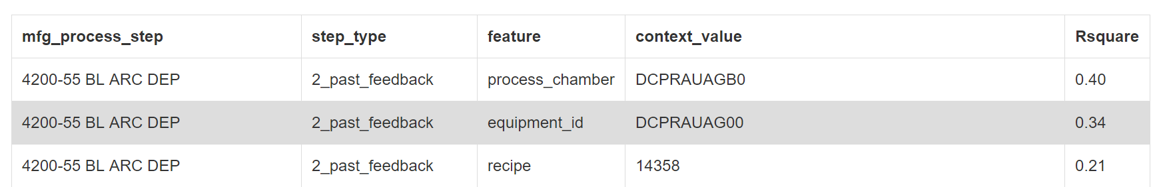
Past lesson learnt / users’ feedback
Accuracy improvement; Available in RDA/PEE AD
This feature currently is available for both RDA AD and PEE AD.
AD will query past feedback cases for same chart and mark past feedback root cause step as feedback step

Slide 18
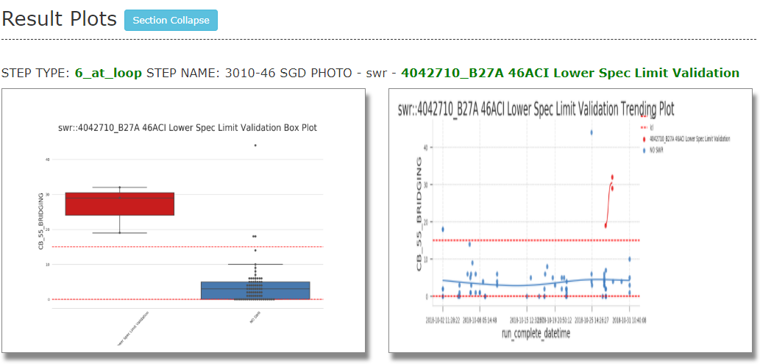
New dataset SWR
Further accuracy improvement; Available in RDA/PEE AD
This feature is able to highlight SWR as the OOC root cause.
Data Source: Teradata
Good use case:

Slide 19
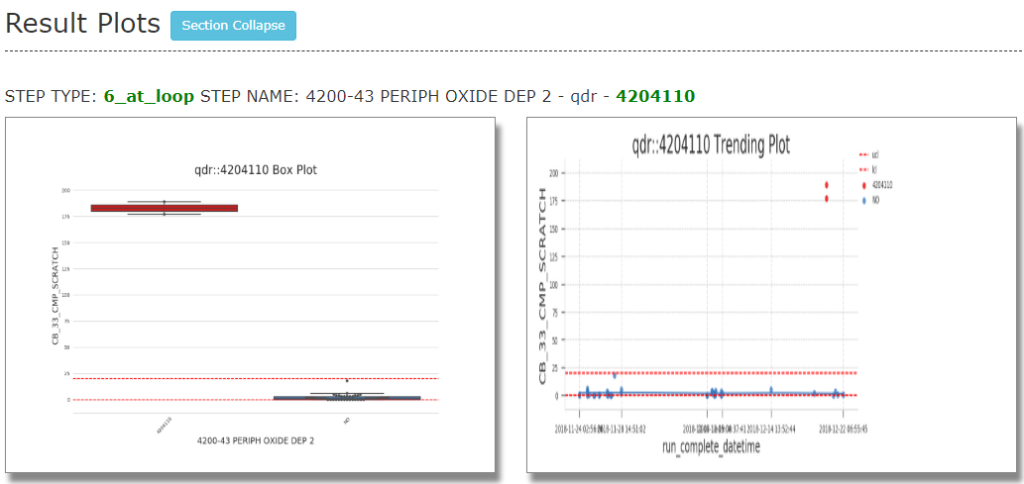
New dataset QDR
Further accuracy improvement; Available in RDA/PEE AD
This feature is able to highlight QDR as the OOC root cause.
Data Source: Teradata
Good use case:

Slide 20
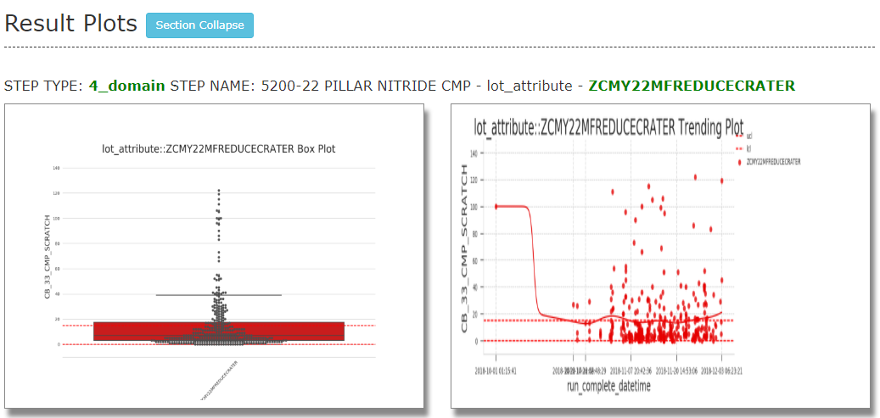
New dataset lot attribute
Further accuracy improvement; Available in RDA/PEE AD
This LT feature is able to highlight lot attribute as the OOC root cause. Usually the lot attributes starting with Z (e.g. ZWPY36POSTSOFTSPRAY) are considered as conversion leading to excursion that users are afraid of.
Data Source: Teradata
Good use case:

Slide 21
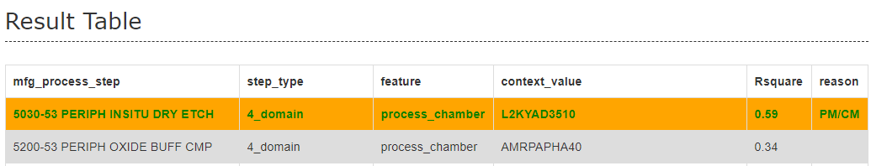
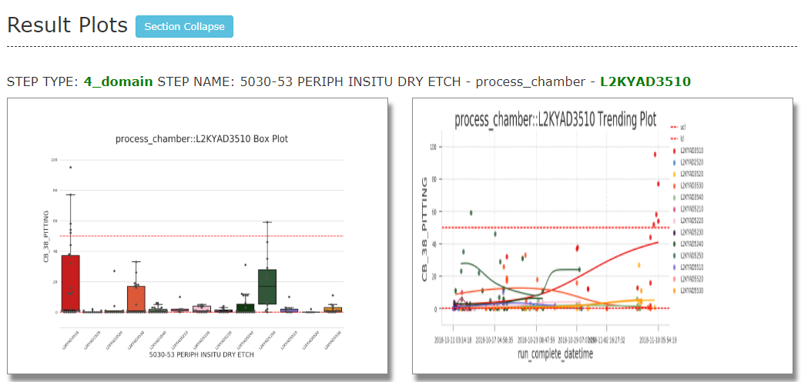
PM/CM checking
Further accuracy improvement; Available in RDA/PEE AD
This feature is aimed to correlate OOC points and PM/CM lead lot to boost up the confidence on root cause finding.
Checking criteria is that we use latest OOC lot and check whether this lot is the first two lots after certain PM/CM for certain step.
Good use case:

Slide 22
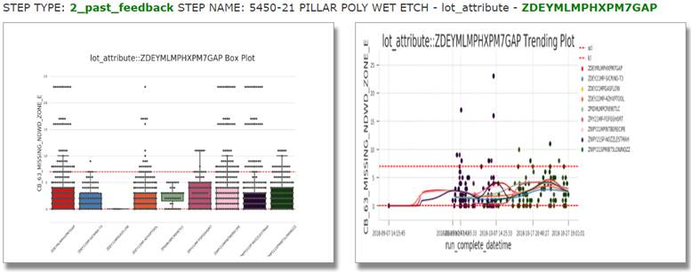
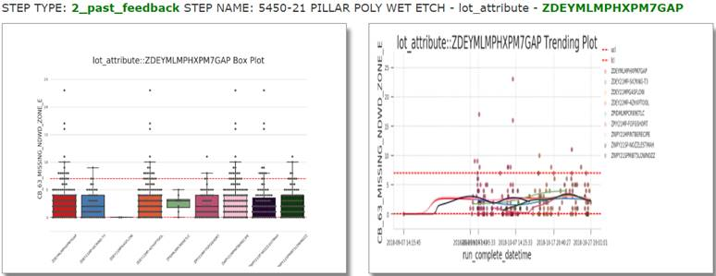
Plot enhancement 1 for SWR/QDR/LT
Friendly UI; Available in RDA/PEE AD
Red label points (root cause) are not so obvious in terms of feature-lot attribute.
Investigated the reasons are 1. Many points from different labels but with the same X-axis and Y-axis values are covered together leading to color mixture. 2. Raw data parsed into the result table for calculating the possibility of root cause got lots of duplicate.
The final solutions are 1. adjusting the transparency of points and 2. dropping duplicate values of data frame. Optimization results are as the following figures in the next slice.
Before
After

Slide 23
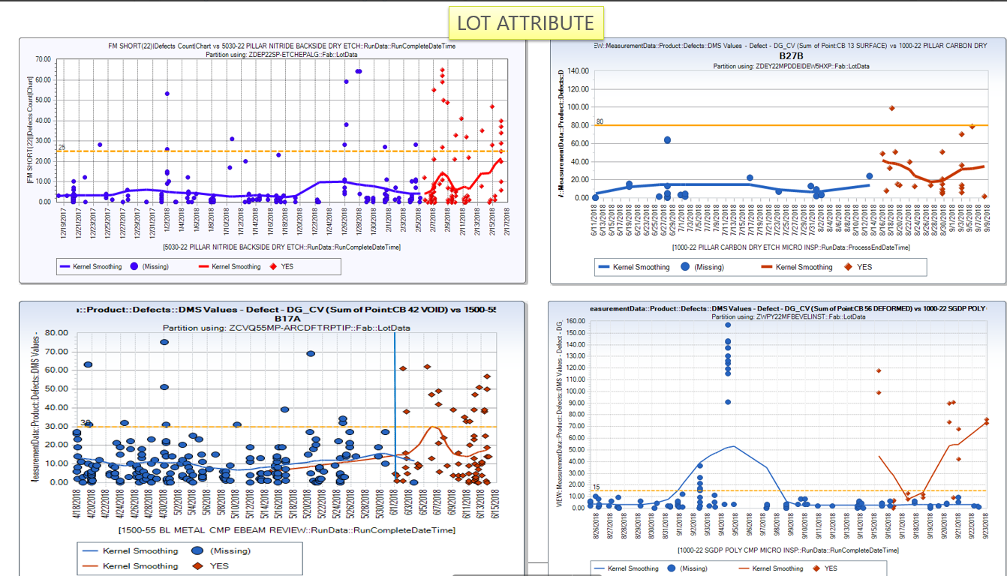
Plot enhancement 2 for SWR/QDR/LT
Friendly UI; Available in RDA/PEE AD
RDA user Si Min gave a feedback that LT analysis should provide only one label's data which is like the following good case, once this highlighted lot attribute came in, the total baseline changed meaning that it is true toggle. However, AD provides a mixture from many LTs which is not a normal way for user to judge root cause.

Slide 24
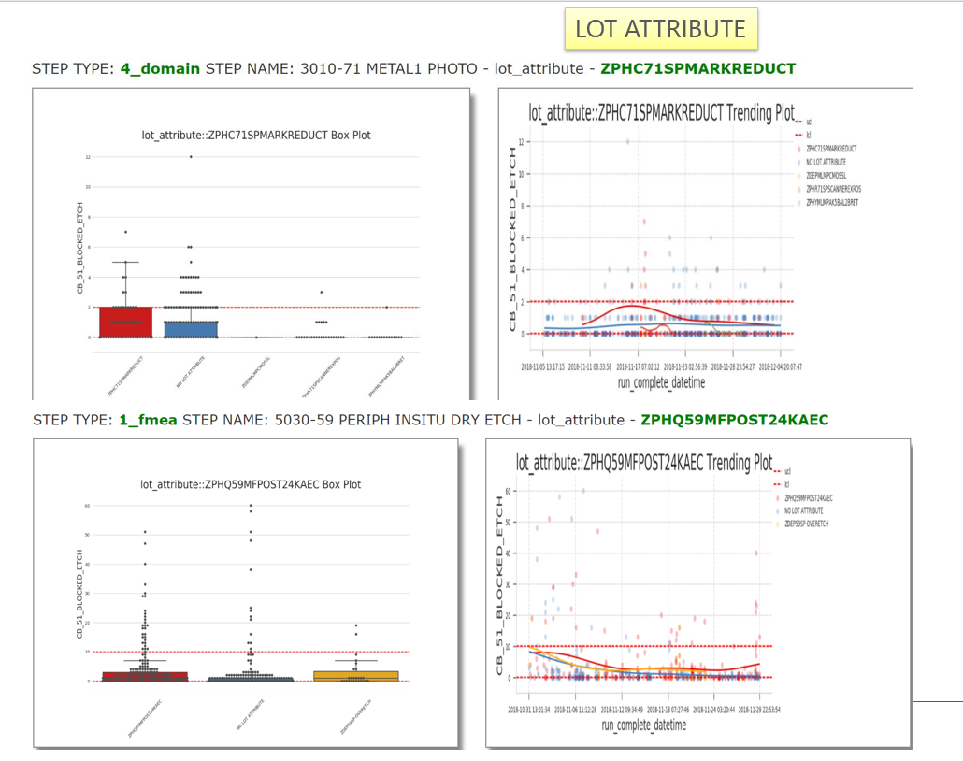
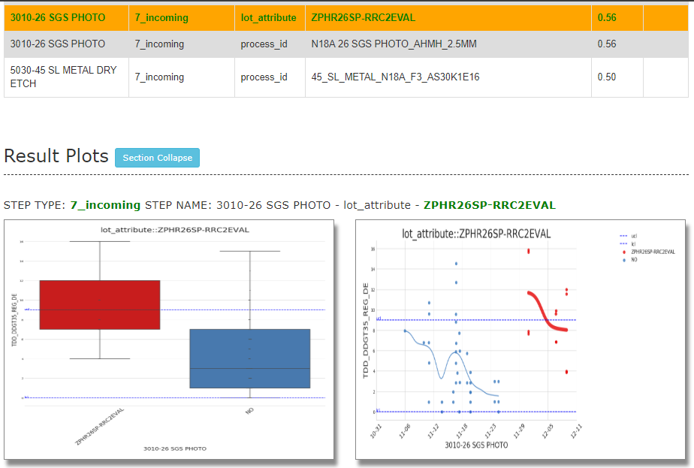
Plot enhancement 2 for SWR/QDR/LT
Friendly UI; Available in RDA/PEE AD
Before
After

Slide 25
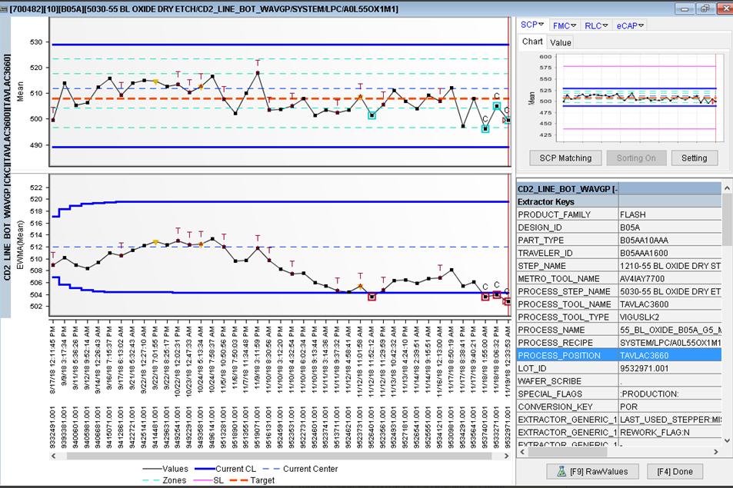
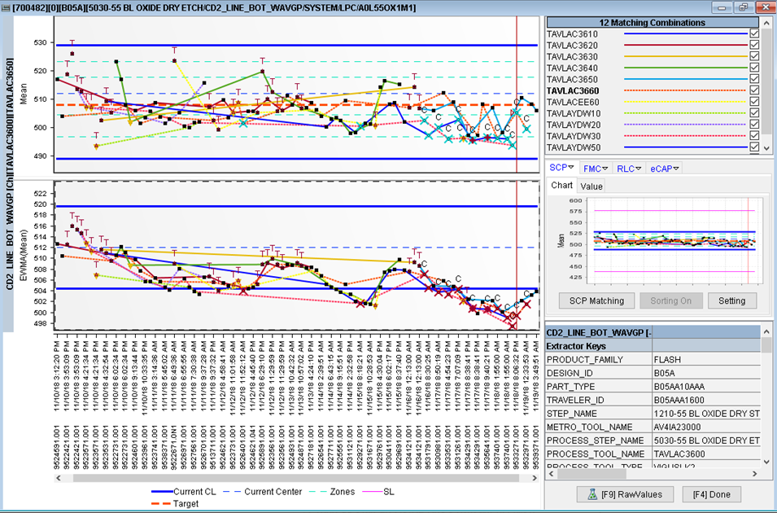
Channel level analysis
Reduce false alarms/Smarter AD; Available in RDA/PEE AD
This feature enables the channel level analysis in AD aimed to give a comparison between highlighted CKCs, which will help to identify incoming toggle and speed up troubleshooting for multiple CKC OOCs with similar issue.
If ckc is not equal to 0, AD will query all samples based on the corresponding channel level.
PEE user Shaun gave the feedback that multiple CKCs highlighted got the same issue.
CKC level
Channel level / multiple CKCs

Slide 26
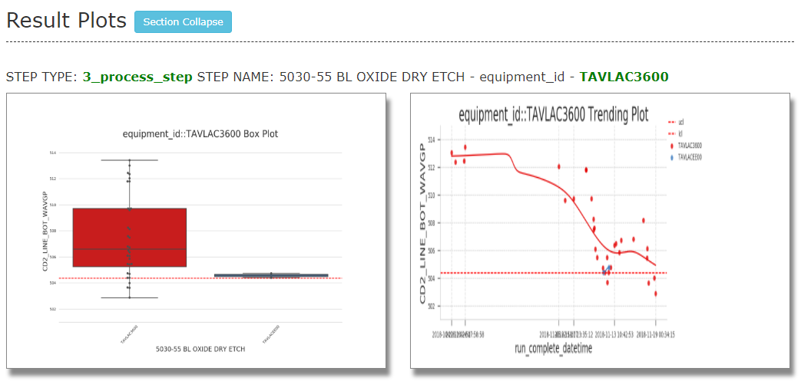
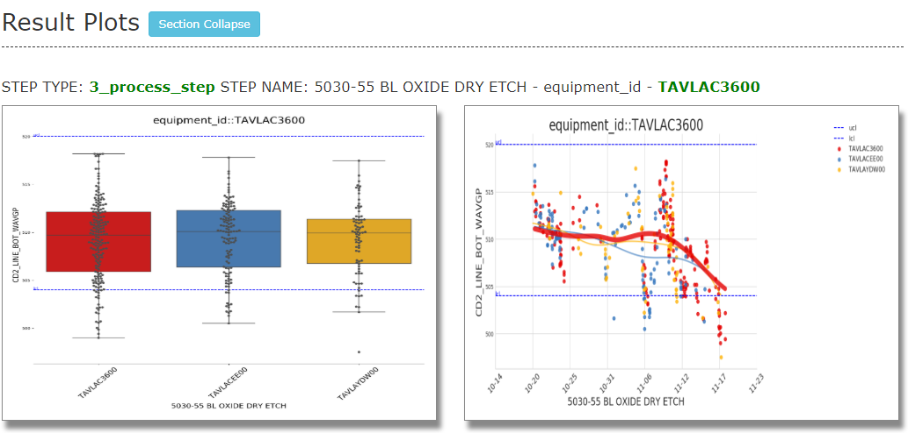
Channel level analysis
Reduce false alarms/Smarter AD; Available in RDA/PEE AD
Before
After
Previous Report vs. After Report

Slide 27
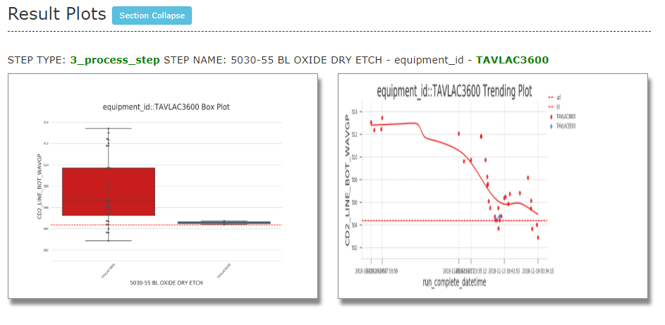
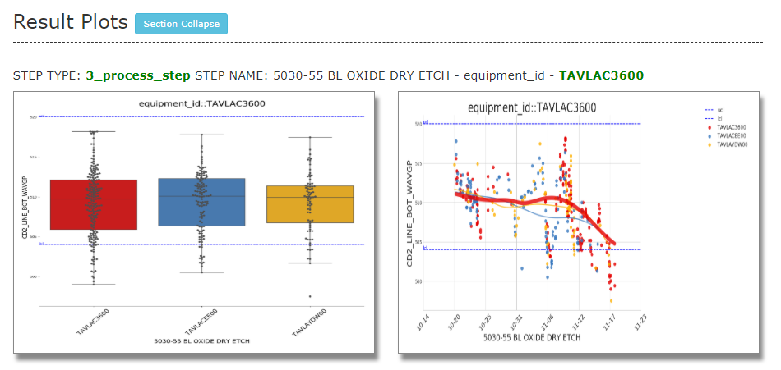
Plot enhancement for channel level analysis
Friendly UI; Available in RDA/PEE AD
Potential Root Cause highlighted in bold red.
Some font size and legend optimization.
Before
After

Slide 28
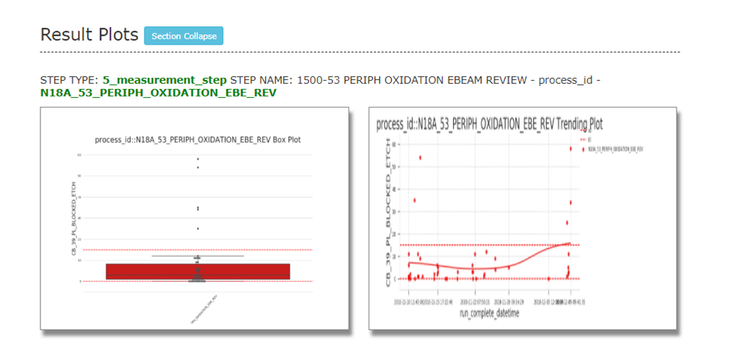
Single context removal
Reduce false alarms/Smarter AD; Available in RDA/PEE AD
if root cause only has one recipe/process id/ etc. do not list in the root cause list. except they are from process step.

Slide 29
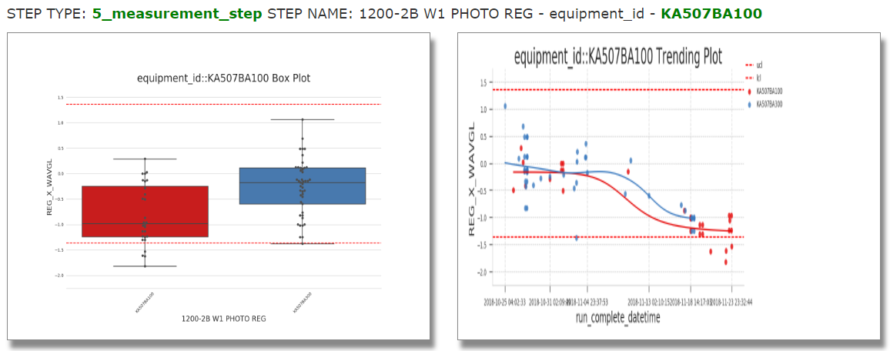
Curve trending detection
Reduce false alarms/Smarter AD; Available in RDA/PEE AD
PEE gave us a feedback that most highlighted toggles are obviously wrong when looking at time trend in one AD report.

Slide 30
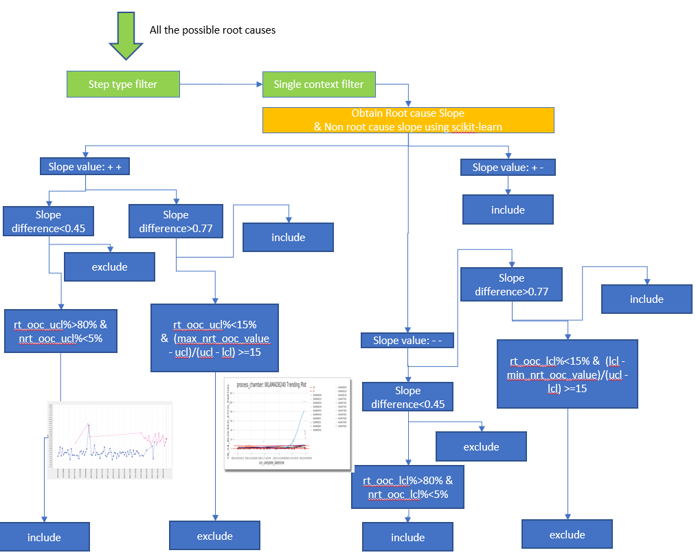
Curve trending detection
Reduce false alarms/Smarter AD; Available in RDA/PEE AD
Why Step type filter?
In order to make sure this new feature won’t filter out the correct found cases leading to decreasing accuracy.
Currently many correct cases from users’ feedback are from FMEA/process step.
Why Single context filter?
This feature needs to keep the same judgement as a new feature that we released recently for filtering the single context value in AD report.
A special handling to make the code more robust: Single context filter is used for the case that non root cause datasets have less than 2 points meaning no slope.

Slide 31
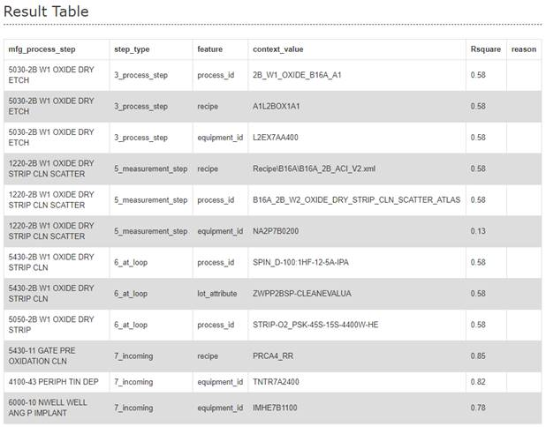
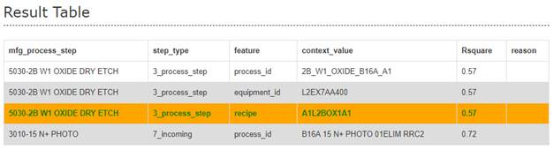
Curve trending detection
Reduce false alarms/Smarter AD; Available in RDA/PEE AD
Comparison 1- Result table
Before
After
AD repot link
AD repot link

Slide 32
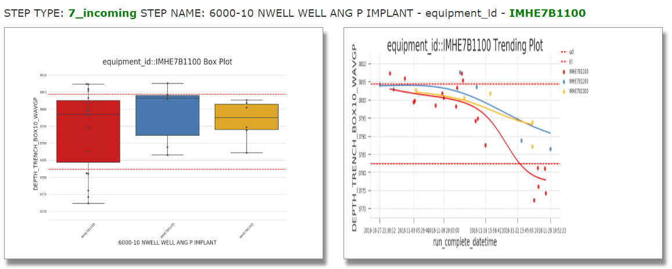
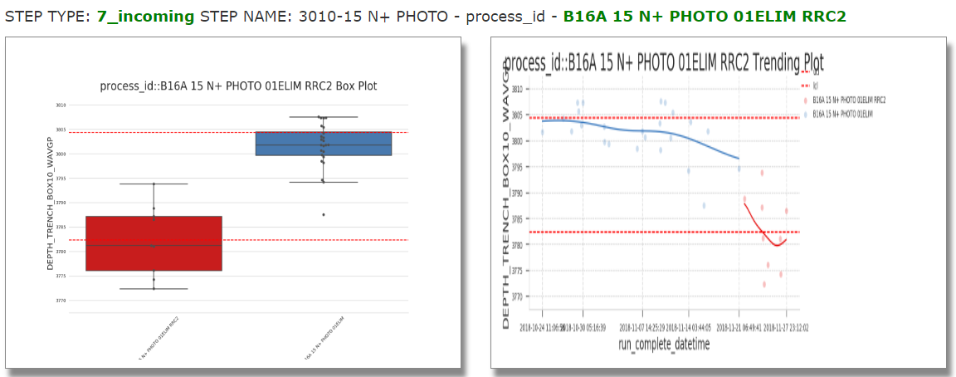
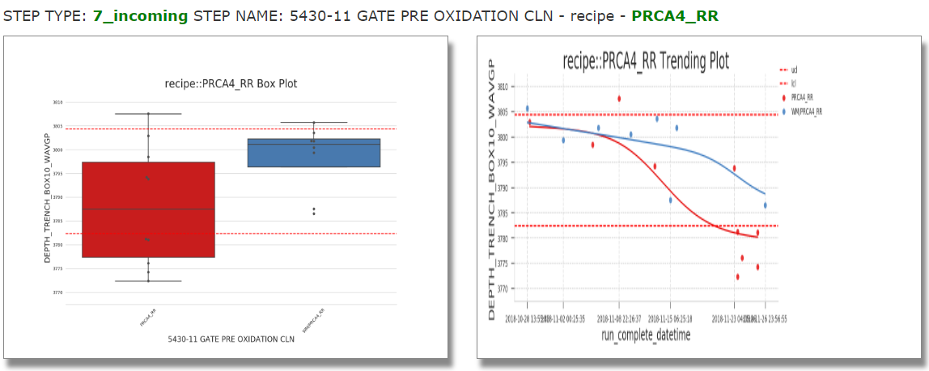
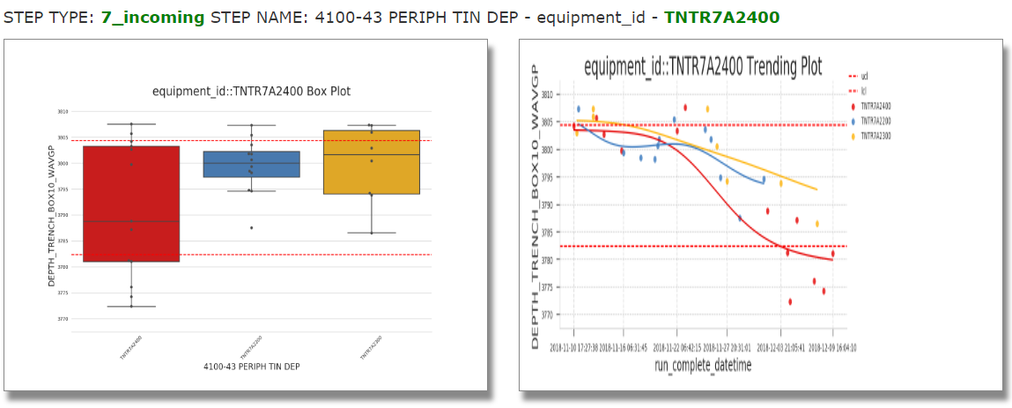
Curve trending detection
Reduce false alarms/Smarter AD; Available in RDA/PEE AD
Comparison 1- plotting
Before
After

Slide 33
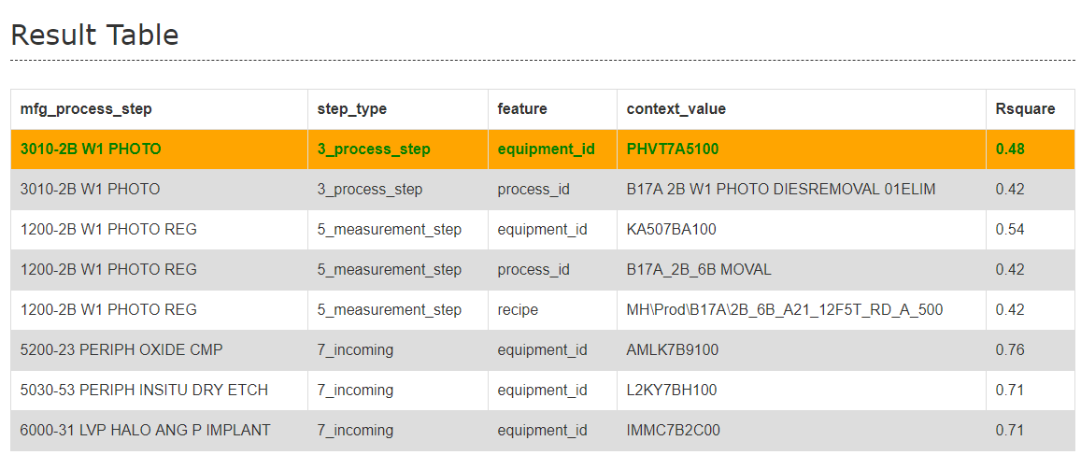
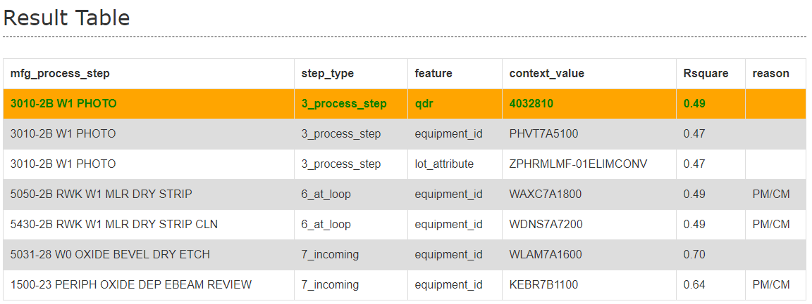
Curve trending detection
Reduce false alarms/Smarter AD; Available in RDA/PEE AD
Comparison 2- Result table
Before
After
AD repot link
AD repot link

Slide 34

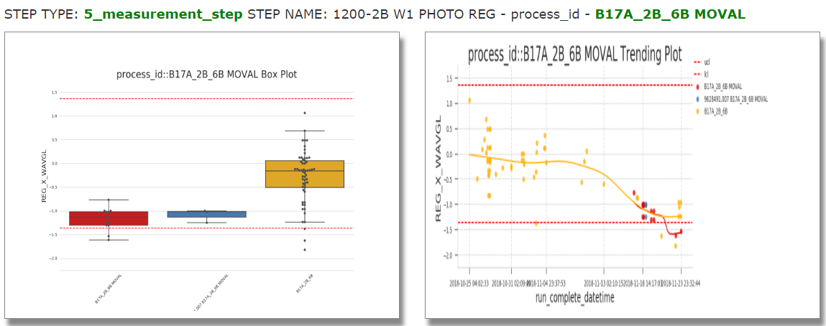
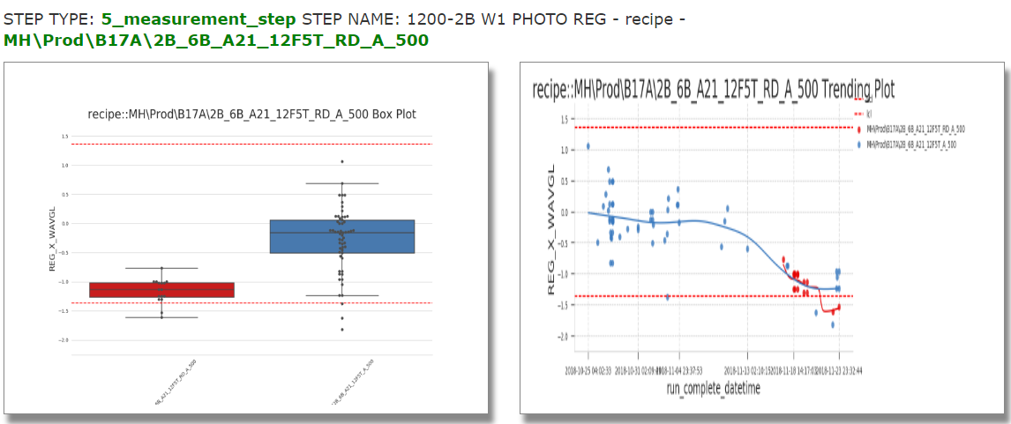
Curve trending detection
Reduce false alarms/Smarter AD; Available in RDA/PEE AD
Comparison 2- plotting from 5_measurement_step
Before
After
No highlight from 5_measurement_step

Slide 35
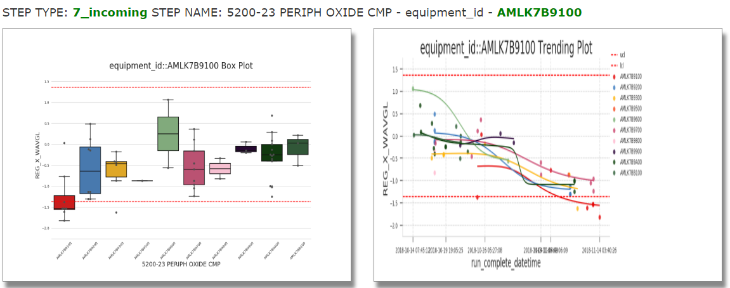
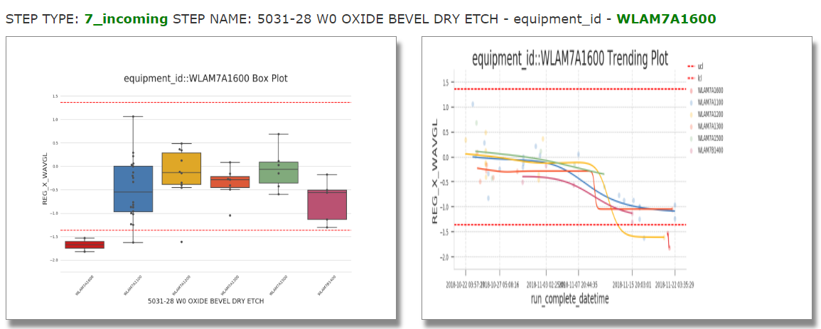
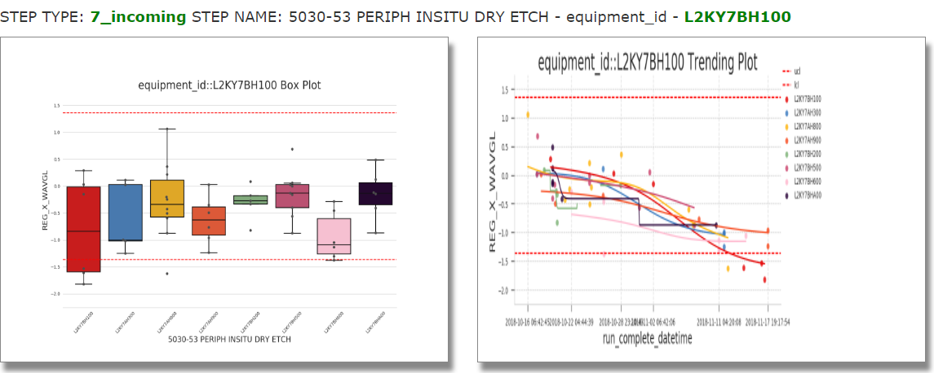
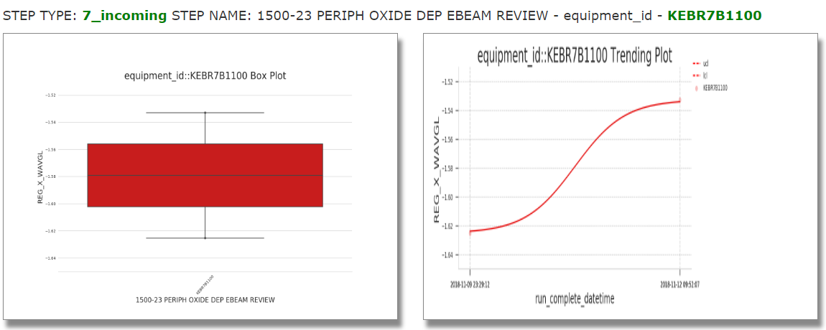
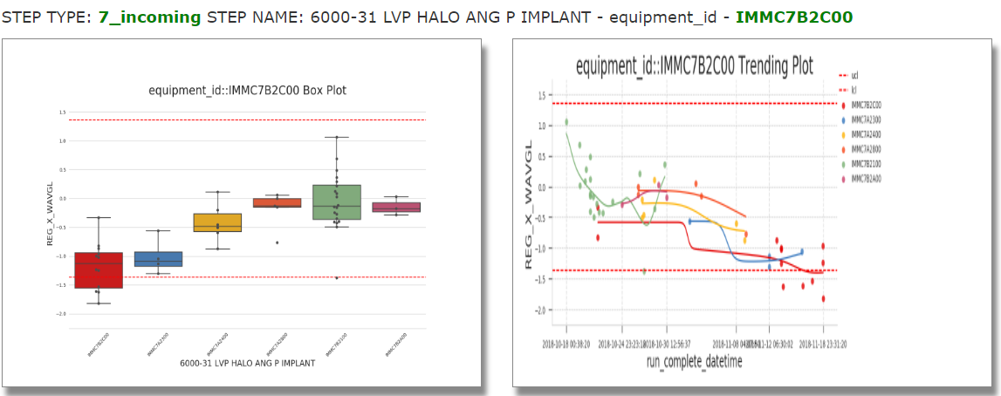
Curve trending detection
Reduce false alarms/Smarter AD; Available in RDA/PEE AD
Comparison 2- plotting from 7_incoming
Before
After

Slide 36
Comparison summary
 |  | ORION AD | Chronic AD
 |  |  | RDA AD | PEE AD
Triggering rule |  | Real-time | scheduled daily
Data source | SPACE | in messages (max 30 points) | Hive (latency: ~3h)
 | Sigma | streaming cluster, HBase, sigma (data latency: <15 mins) | prod cluster, HBase, sigma (data latency: 40mins~1h)
 | Teradata | N/A | new datasets SWR/QDR/lot attribute/PM_CM checking are using Teradata
Feature | Basic checking | pair correlation | pair correlation
 | Accuracy improvement | N/A | time weighted analysis
 |  |  | FMEA | N/A
 |  |  | domain knowledge | N/A
 |  |  | past lesson learnt / users’ feedback
 | Further accuracy improvement (adding in new datasets) | N/A | new datasets SWR/QDR/lot attribute
 |  |  | PM/CM checking (future: Fault detection)
 | friendly UI | N/A | plot enhancement
 | Reduce false alarms / Provide more meaningful root causes / Smarter AD | N/A | channel level analysis
 |  |  | single context removal
 |  |  | curve trending detection

Slide 37
Reference
Team is building a common confluence page for users’ guidance, issue tracking, every meeting’ headline and all the ongoing features for AD.
More details:
ORION AD: https://confluence.micron.com/confluence/display/WWDS/ORION+AD
Chronic AD: https://confluence.micron.com/confluence/display/WWDS/Chronic+AD
Ongoing features: https://confluence.micron.com/confluence/display/WWDS/Ongoing+Features

Slide 38
Acknowledgement
Special Thanks to below team members:
RDA: Si Min Wong (wongsimin), Wi Hoong Lim (wihoong)
PEE: Lingjie Ma (malingjie), Theodora Karin Dharmanto (theodorakd), Himavad Ram Gopal (himavadgopal), Shaun Teo (shaunteohw), Zheng Hoe Chooi (zhenghoe), Guo Jun Guo (guojun), William Cheong (williamc), Kok Boon Chong (kokboon)
IT: Dudy Lim (dudylim), Sio Kek Yim (yimsiokek)
All existing and past DS team members involved in AD projects.

